Slide 1

Rakan Alharbi
Text Classification on Tweets about COVID-19

Slide 2
Outline:
Introduction
EDA
NLP

Slide 3
Introduction:
The main goal of this issue is to categorize the sentiment of the tweet related to COVID-19. Initially, endoscopy is performed to infer the data. Tweets [Unstructure data] are converted into numbers [Structured data] by removing stop words, punctuation, markup, and hashes.

Slide 4
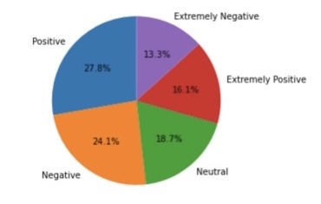
1-Positive
2-Negative
3-Neutral
4-Extremely Positive
5-Extremely Negative

Slide 5
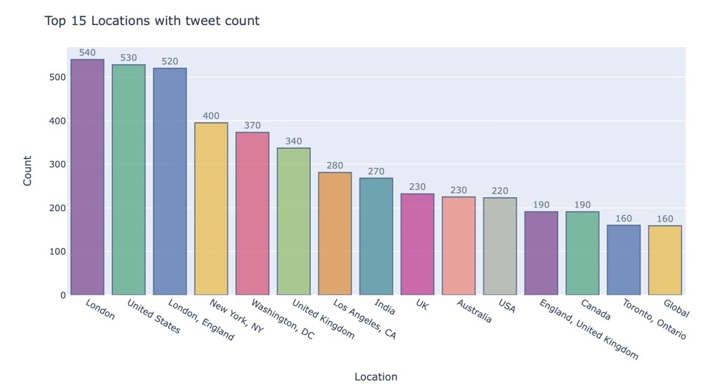
Top 15 Locations with tweet count:

Slide 6
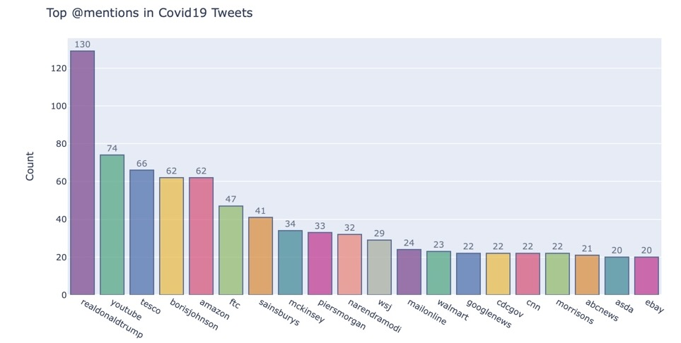
Top @mentions in Covid19 Tweets:

Slide 7
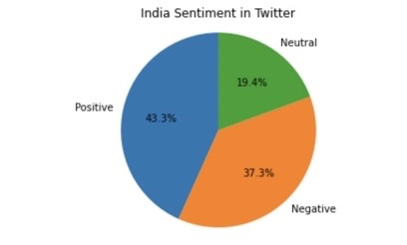
India Sentiment in Twitter:

Slide 8
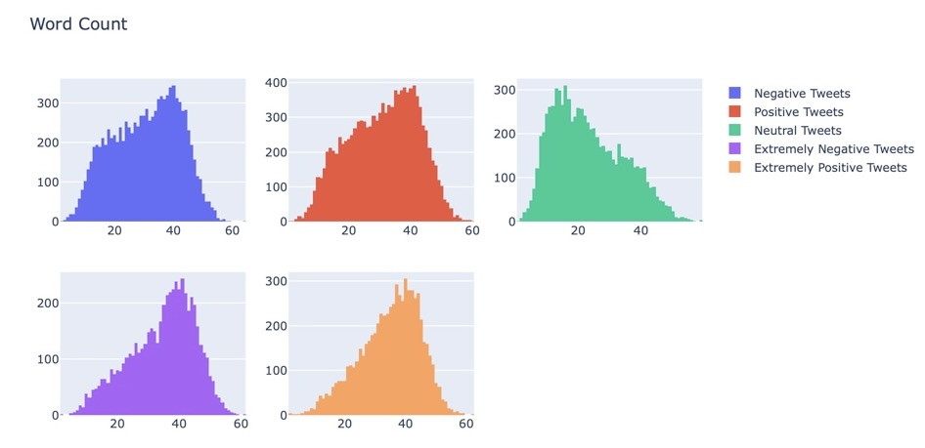
Word Count for each sentiment:

Slide 9
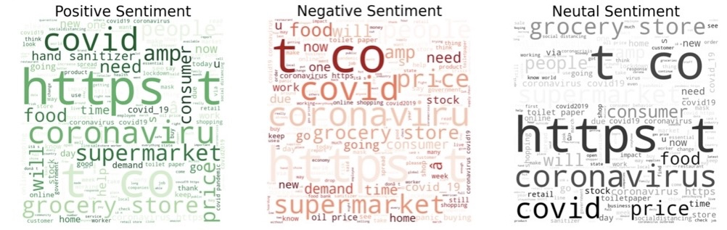
These are some commonly used words before cleaing data.

Slide 10
Sentiment converted to numbers:
Positive=0
Negative=1
Neutral=2
Extremely Positive=3
Extremely Negative=4

Slide 11
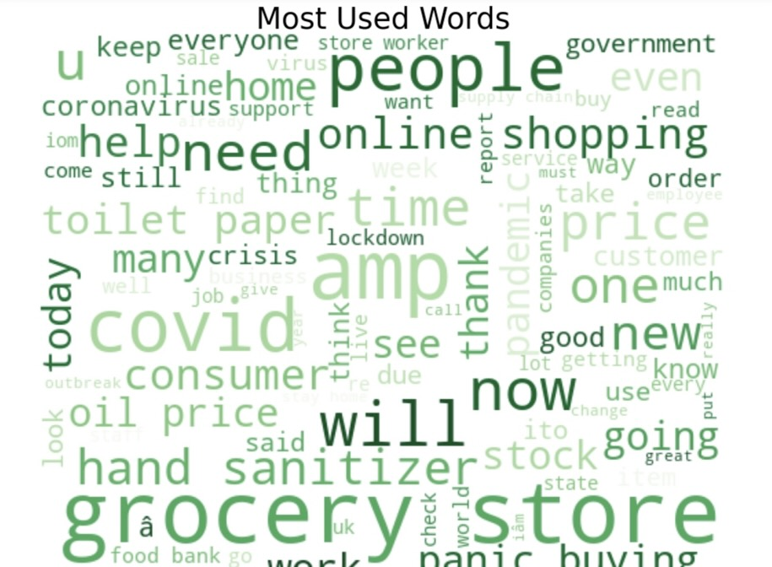
The most common used words are online shopping, grocery, toilet papers, panic buying. This infer the demand of toilet papers in USA at the moment of lockdown period

Slide 12
display topics:
Topic 0
covid, store, food, grocery, price
Topic 1
store, grocery, worker, employee, people

Slide 13
CountVectorizer:
vectorizer.vocabulary_:
trending: 12506
new: 8297
yorkers: 13777
Encounter:4344

Slide 14
LogisticRegression: ACCURACY OF THE MODEL 0.42
RandomForestClassifier:ACCURACY OF THE MODEL: 0.38

Slide 15
thanks

